Slide 1
C2P India
QA Track

Slide 2
Introduction and Agenda
Opportunity To Learn OPF
Opportunity To Learn xCT
Learn QA Processes and Guidelines
Tools Used For Testing
Functional Hands On Exercise

Slide 3
OPF Academy – QA Training Scope
OPF training program provides training on QA Processes, Tools and OPF/ XCT exercises
Introduction To Wiki/Confluence
OPF Payment Testing Solution
SVN structure walkthrough
QA Involvement in SDLC

Slide 4
OPF Academy – QA Training Scope
Reading & Understanding Requirements
QA Tools Introduction
VSDK
JIRA
SPIRA
OPF xCT Functional Exercises
QA Checklists
Daily Training
Daily Assignments

Slide 5
Scope
Introduction To Wiki/Confluence
OPF Payment Testing Solution
SVN structure walkthrough
QA Involvement in SDLC

Slide 6
Introduction To Wiki/ Confluence
Wiki is a global space where you will be able to find information on the Products & Solutions Portfolio, Roadmaps, Teams, Competence Centers etc.
https://wiki.clear2pay.com/display/OPFOPS/Quality+Assurance+Competence+Center
https://wiki.clear2pay.com/display/OKB/Quality+Assurance+KB
https://wiki.clear2pay.com/pages/viewblogposts.action?period=2&postingDate=2014%2F11%2F1&key=OTS
Login with your domain credentials.

Slide 7
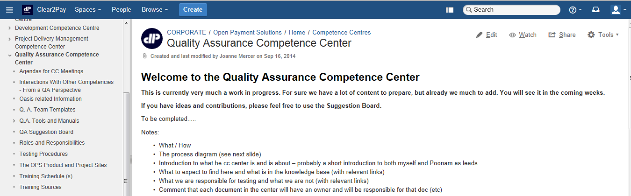
Wiki - QA Competence Center
https://wiki.clear2pay.com/display/OPFOPS/Quality+Assurance+Competence+Center

Slide 8
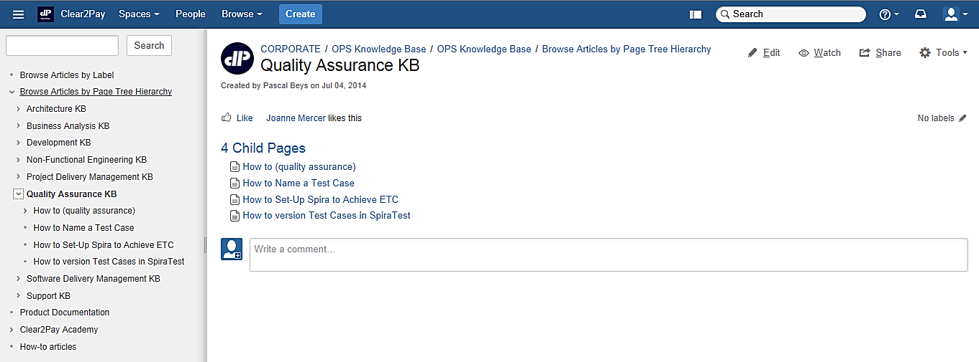
Wiki - QA Knowledge Base
https://wiki.clear2pay.com/display/OKB/Quality+Assurance+KB

Slide 9
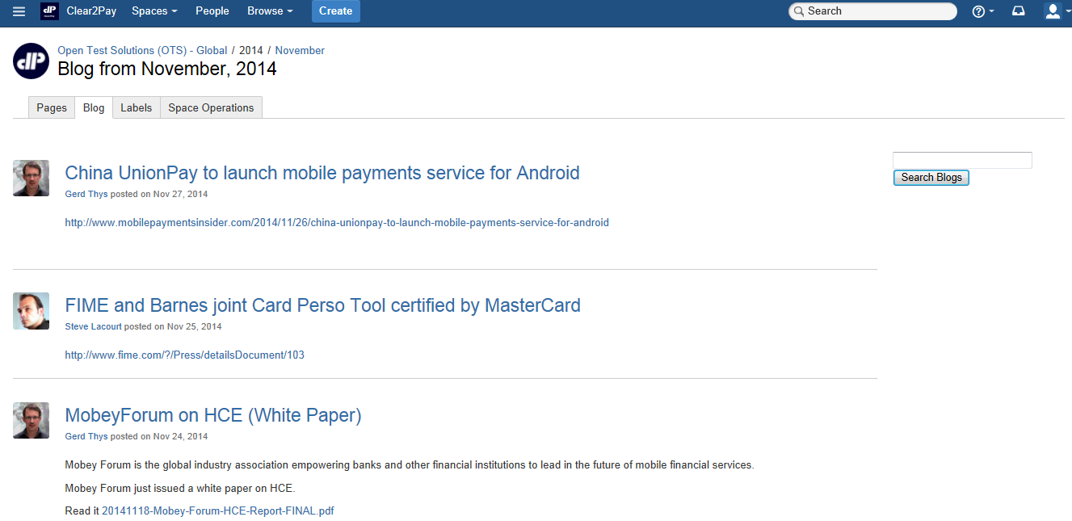
Wiki - Blog Sharing
https://wiki.clear2pay.com/pages/viewblogposts.action?period=2&postingDate=2014%2F11%2F1&key=OTS

Slide 10
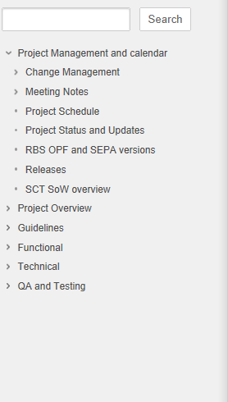
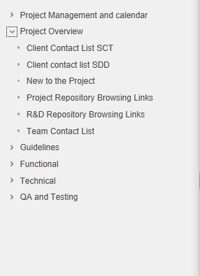
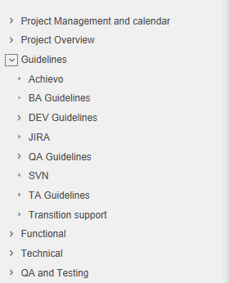
Wiki - Project Specific Info

Slide 11
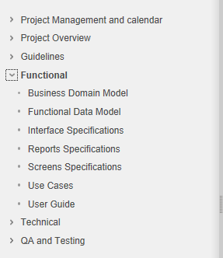
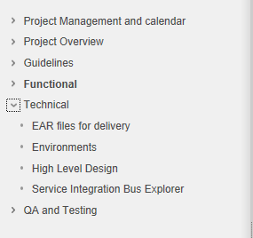
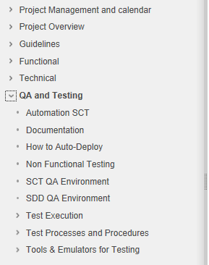
Wiki - Project Specific Info

Slide 12
Scope
Introduction To Wiki/Confluence
OPF Payment Testing Solution
SVN structure walkthrough
QA Involvement in SDLC

Slide 13
OPF Payment Testing Solution
Managed Service for Testing All Aspects of a Payment Environment
Payment testing Lifecycle
Accelerators
Initiation
Team Identification
Kick Off Meeting
Planning
Scheduling
Test Strategy / Test Planning
Test Design
Test Scenario / Cases / Data
Execution & Reporting
Project On-boarding
Tool Set-up
Traceability Matrix
Test Case Review and Sign-Off
Manual and Automation
Defect Management
Status Reporting / Sign-Off
Test
Repository
Domain
Experience
Test
Automation
ISO 20022, SEPA, US/UK/SG Payments
OASIS – E2E Test Automation
Full Testing Coverage
Functional
Interface
Regression
New Systems, Business Enhancements, Regulatory Compliance
Key Benefits
Experienced
Good Quality
Proven

Slide 14
OPF QA Delivery Model
OPF Engagement 1
OPF Engagement 2
OPF Engagement 3
Optimal resource utilization
Payment SME facilitate smooth knowledge acquisition
Automation experts define automation strategy and framework
Experienced OPF QA specialist help in test preparation & execution
Supported and managed by well qualified, experienced management team
OPF QA Specialist
(dedicated team)
OPF QA Specialist
(dedicated team)
OPF QA Specialist
(dedicated team)
Payments Subject Matter Experts
Delivery/Test Management and Project Monitoring
Shared Automation Framework Resource Pool
OPF QA CC: Process Implementation & Monitoring
Resource Management & Training Fulfillment

Slide 15
Scope
Introduction To Wiki/Confluence
OPF Payment Testing Solution
SVN structure walkthrough
QA Involvement in SDLC

Slide 16
QA Involvement in SDLC
Functional Test Team
Business (BA Group)
Delivery Management
Development / Technical Architecture
Software Configuration Management
Elaboration Phase
Project Kick Off meetings.
Construction Phase
Functional Testing and KT from BA.
Technical support from Dev/TA.
Transition Phase
Functional Testing and KT from BA.
Technical support from Dev/TA.
Knowledge transfers from BA to facilitate test planning and scheduling.

Slide 17
Scope
Introduction To Wiki/Confluence
OPF Payment Testing Solution
SVN structure walkthrough
QA Involvement in SDLC

Slide 18
SVN
About SVN
Apache Subversion (often abbreviated SVN, after the command name svn) is a Software Versioning and a Revision Control system.
It is where we store all our documentation.
OPF
https://svn-mec.clear2pay.com/svn/repos/rd/core/OPF/trunk/doc
XCT
https://svn-mec.clear2pay.com/svn/repos/rd/core/XCT/trunk/doc
It is suggested that the tester should take the checkout on its local working directory.

Slide 19
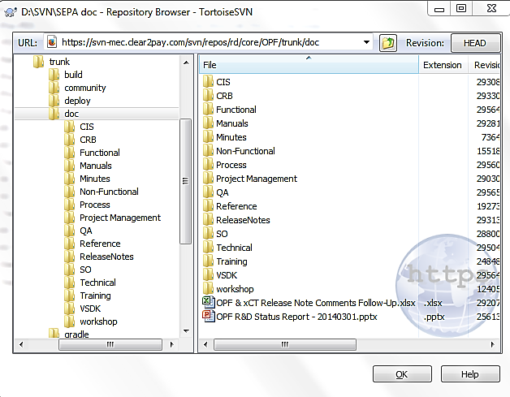
SVN Structure
Documents
All the documents are stored in their respective SVN location (i.e. under .../trunk/doc/...) as can be seen below.

Slide 20
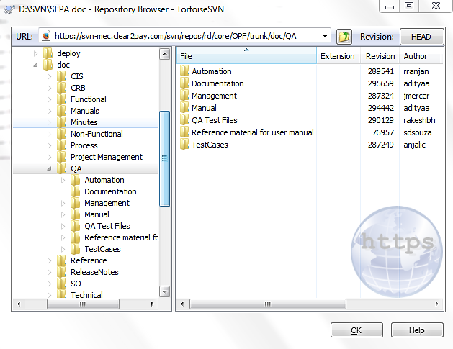
SVN Structure - QA
QA documents
All the QA docs are stored in their respective SVN location (i.e. under .../trunk/doc/...) as can be seen below. This includes all test data used.

Slide 21
SVN Structure – Requirements (1)
Specifications
All the functional specifications like Use Cases and Functional Flow are held here:
Product | Specifications and reference documentation
OPF | https://svn-mec.clear2pay.com/svn/repos/rd/core/OPF/trunk/doc/Functional
XCT | https://svn-mec.clear2pay.com/svn/repos/rd/core/XCT/trunk/doc/Functional

Slide 22
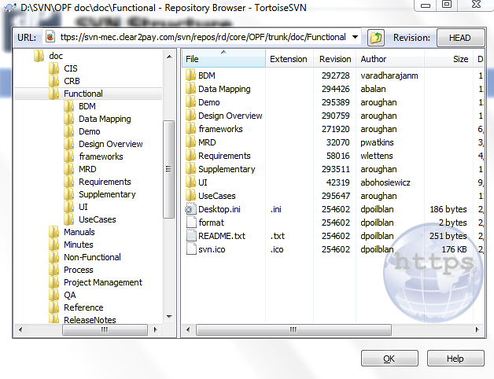
SVN Structure – Requirements (2)
Specifications

Slide 23
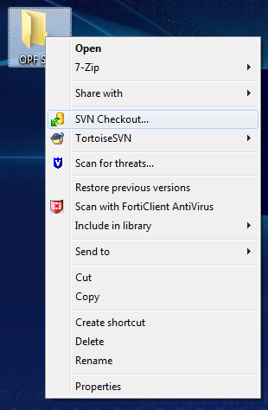
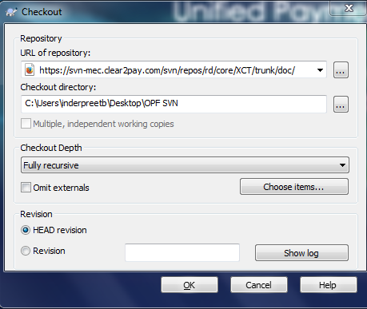
SVN Checkout

Slide 24

Question & Answers

Slide 25
EMEA – Headquarters
Brussels, Belgium
info@clear2pay.com
APAC
Sydney, Australia
info.apac@clear2pay.com
Americas
Atlanta, USA
info.americas@clear2pay.com
www.clear2pay.com

